Slide 1
WEEK 8

Slide 2
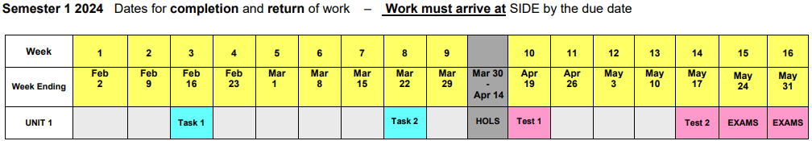
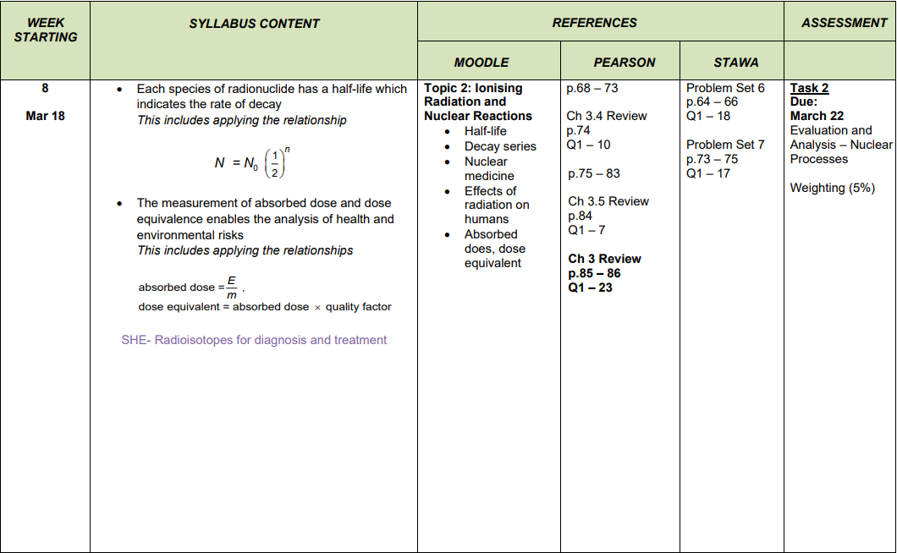

Slide 3
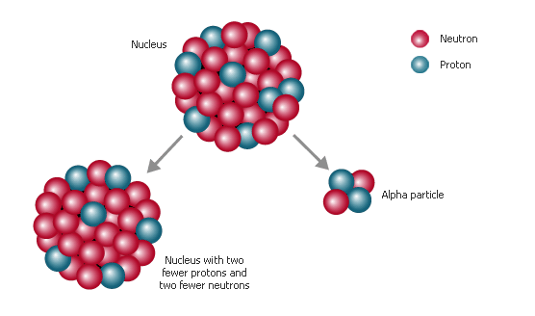
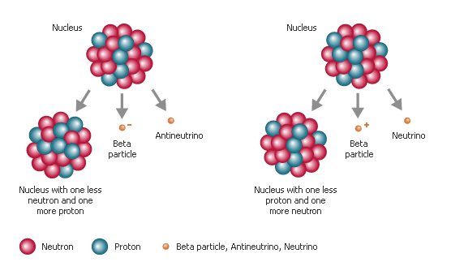
Radioactive Decay
Alpha decay and beta decay are two forms of radioactive decay. In all forms of radioactive decay, an atom emits particles and energy.
Scientists use this natural breakdown of isotopes to accurately measure the absolute age of rocks.
The method of using radioactive decay to measure absolute age is called radiometric decay.
Notes:
Image from the website: http://encarta.msn.com/media_701507530_761567432_-1_1/alpha_decay.html (top) and http://encarta.msn.com/media_461530753_761564649_-1_1/beta_decay.html (bottom)

Slide 4
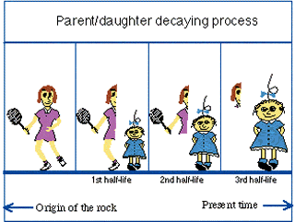
Parent / Daughter Isotopes
As an atom emits particles and energy, the atom changes into a different isotope of the same element or an isotope of a different element. Scientists measure the concentrations of the original radioactive isotope (known as the parent isotope), and of the new formed isotopes (known as the daughter isotope).
Using the known decay rate, the scientists compare the proportions of the parent and daughter isotopes to determine the absolute age of the rock.
Notes:
Image is from the website: http://minerals.cr.usgs.gov/gips/na/radio.html

Slide 5
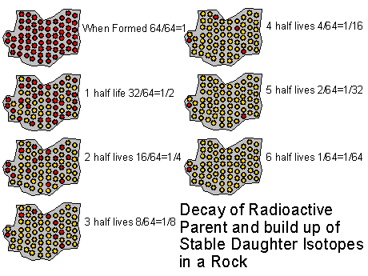
Half-life*
Radioactive decay happens at a relatively constant rate that is not changed by temperature, pressure, or other environmental conditions. Scientists have determined that the time required for half of any amount of a particular radioactive isotope to decay is always the same and can be determined for any isotope.
Therefore, a half-life is the time it takes half the mass of a given amount of radioactive isotope to decay into its daughter isotopes.
Notes:
Image is from the website: http://faculty.weber.edu/bdattilo/shknbk/notes/time.htm

Slide 6
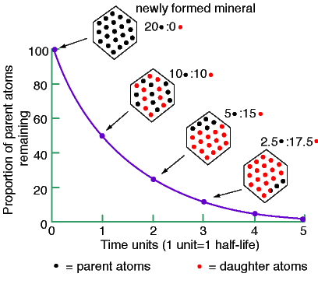
Calculating Half-life*
If you begin with 20 g of a parent isotope, you would have 10 g of that isotope after one half-life of that isotope. At the end of a second half-life, you would have 5 g of that isotope. At the end of a third half-life, you would have, one-eighth, or 2.5 g of the original isotope remaining. At that point, three-fourths of the sample would now be the daughter isotope.
Notes:
Image from the website: http://www.kgs.ku.edu/Extension/geotopics/earth_age.html

Slide 7
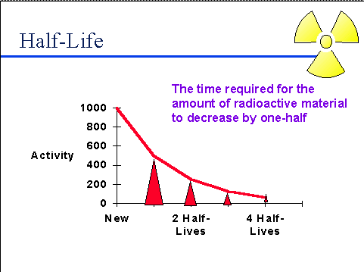
Half-life
By comparing the amounts of parent and daughter isotopes in a rock sample, scientists can determine the age of the sample. The greater the percentage of daughter isotopes present in the sample, the older the rock is.
But comparing parent to daughter isotopes only works when the sample has not gained or lost either parent or daughter isotopes through leaking or contamination.
Notes:
Image is from the website: http://web.princeton.edu/sites/ehs/osradtraining/radiationproperties/radiationproperties.htm

Slide 8
Math Skills – Half-life
A sample contains 1000 g of an isotope that has a half-life of 500 years. How many half-lives will have to pass before the sample contains less than 10 g of the parent isotope? (just divide by 2)
After 1 half-life (500 years), 500 g of the parent isotope will remain.
After 2 half-lives (1000 years), 250 g of the parent isotope will remain.
After 3 half-lives (1500 years), 125 g of the parent isotope will remain.
After 4 half-lives (2000 years), 62.5 g of the parent isotope will remain.
After 5 half-lives (2500 years), 31.25 g of the parent isotope will remain.
After 6 half-lives (3000 years), 15.625 g of the parent isotope will remain.
After 7 half-lives (3500 years), 7.8125 g of the parent isotope will remain.

Slide 9
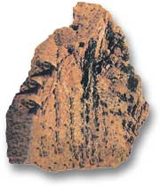
Radioactive Isotopes
Rocks generally contain small amounts of radioactive material that can act as natural clocks. Atoms of the same element that have different numbers of neutrons are called isotopes. Radioactive isotopes have nuclei that emit particles and energy at a constant rate regardless of surrounding conditions.
Uranium Ore
Notes:
Image is from the website: http://www.uraniumsa.org/about/what_is_uranium.htm

Slide 10
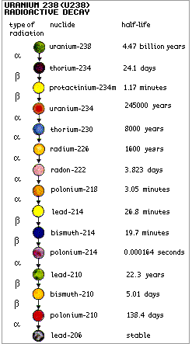
Radioactive Isotopes
The amount of time that has passed since a rock formed determines which radioactive element will give a more accurate age measurement. If too little time has passed since radioactive decay began, there may not be enough of the daughter isotope for accurate dating. If too much time has passed, there may not be enough of the parent isotope left for accurate dating.
Notes:
Image is from the website: http://www.world-nuclear.org/education/ral.htm

Slide 11
Radioactive Isotopes
Uranium-238 has an extremely long half-life of 4.5 billion years. It is most useful for dating geologic samples that are more than 10 million years old, as long as they contain uranium.
Other isotopes are also used to date rock samples. Potassium-40 has a half-life of 1.25 million years. Potassium-40 occurs in mica, clay, and feldspar and is used to date rocks that are between 50,000 and 4.6 billion year old.
Rubidium-87 has a half-life of about 49 billion years. Rubidium-87 commonly occurs in minerals that contain potassium-40, so it can be used to verify the age of rocks previously dated by using potassium-40.

Slide 12
Carbon Dating*
Younger rock layers may be dated indirectly by dating organic material found within the rock. The ages of wood, bones, shells, and other organic remains that are included in the layers and that are less than 70,000 years old can be determined by using a method known as carbon-14 (or radiocarbon) dating.
The isotope carbon-14 combines with oxygen to form radioactive carbon dioxide. Most carbon dioxide in the atmosphere contains nonradioactive carbon-12. Only a small amount of carbon dioxide in the atmosphere contains carbon-14.

Slide 13
Carbon Dating
Plants absorb carbon dioxide which contains either carbon-12 or carbon-14 during photosynthesis. Then, when animals eat the plants or the plant-eating animals, the carbon-12 and carbon-14 become part of the animals’ body tissues. Thus, all living organisms contain both carbon-12 and carbon-14.

Slide 14
Carbon Dating
To find the age of a small amount of organic material, scientists first determine the ratio of carbon-14 to carbon-12 in the sample. Then, they compare that ratio with the ratio of carbon-14 to carbon-12 known to exist in a living organism. While organisms are alive, the ratio of carbon-14 to carbon-12 remains relatively constant.
When a plant or an animal dies, the ratio begins to change. The half-life of carbon-14 is only about 5,730 years. Because the organism is dead, it no longer absorbs carbon-14 and carbon-12, and the amount of carbon-14 in the organism’s tissues decreases steadily as the radioactive carbon-14 decays to nonradioactive nitrogen-14.

Slide 15
Radiometric Dating
Now that you have learned about the different radiometric dating methods (isotopes), can you explain why carbon-14 can be used to date a 40,000 year old tree, but uranium cannot?
The 40,000 year old tree is/was a living organism. Remember, all living organisms contain both carbon-14 and carbon-12. Thus, radiocarbon dating would be an appropriate method to use to determine the date of the tree. Uranium is used to date rock samples that are more than 10 million years old.

Slide 16
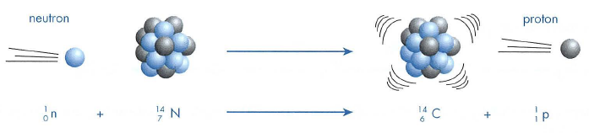
Formation of Carbon-14
The amount of carbon-14 in the atmosphere is fairly constant, due to the effect of cosmic rays. Energetic neutrons are absorbed by nitrogen atoms and carbon-14 is created.

Slide 17
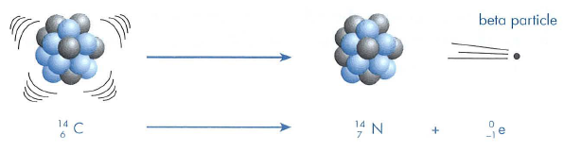
Decay of Carbon-14
Carbon – 14 is unstable, and eventually decays to nitrogen by emitting a beta particle.
The carbon-14 isotope has a half-life of approximately 5730 years.

Slide 18
Carbon Dating
Carbon dating is possible due to the presence of minute quantities of radioactive carbon-14 in the atmosphere.
C-14 is taken in by plants as carbon dioxide and by animals through their food.
When a living thing dies it stops taking in carbon-14.
The percentage of carbon-14 in the organisms remains drops off at a known rate
By comparing the carbon-14 to carbon-12 ratio in the remains it is possible to tell its age.
Carbon dating is useful for dating once living organisms up to about 50,000 years
Notes:
This same method can be used to age older objects
by making use of radioactive isotopes with longer half lives. Uranium-238 has a half life of 4.5 x 109
years and is useful for determining the age of rocks.

Slide 19
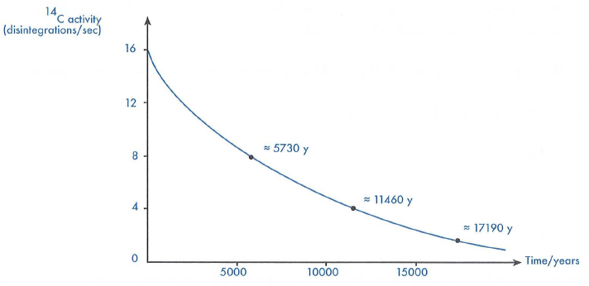
Carbon Dating Graph
Carbon-14 decay curve. The age of once living organisms can be determined from measurement of the carbon-14 activity present in the specimen.

Slide 20
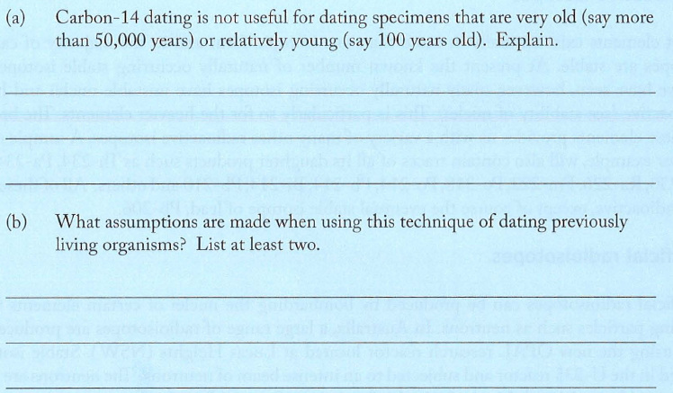
Question 2.3

Slide 21
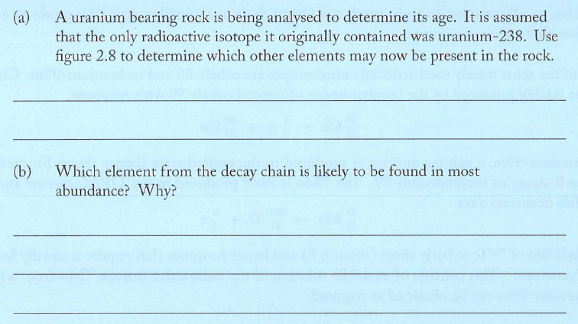
Question 2.4 a & b

Slide 22
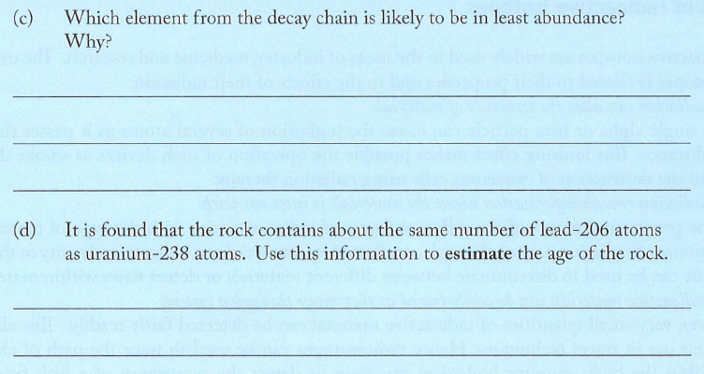
Question 2.4 c & d

Slide 23
Question
There are 9.00 x 10¹⁸ atoms in a sample of a radioactive element. If the element has a half-life of 10.0 minutes, calculate how many atoms of this element remain after 1.00 hour.

Slide 24
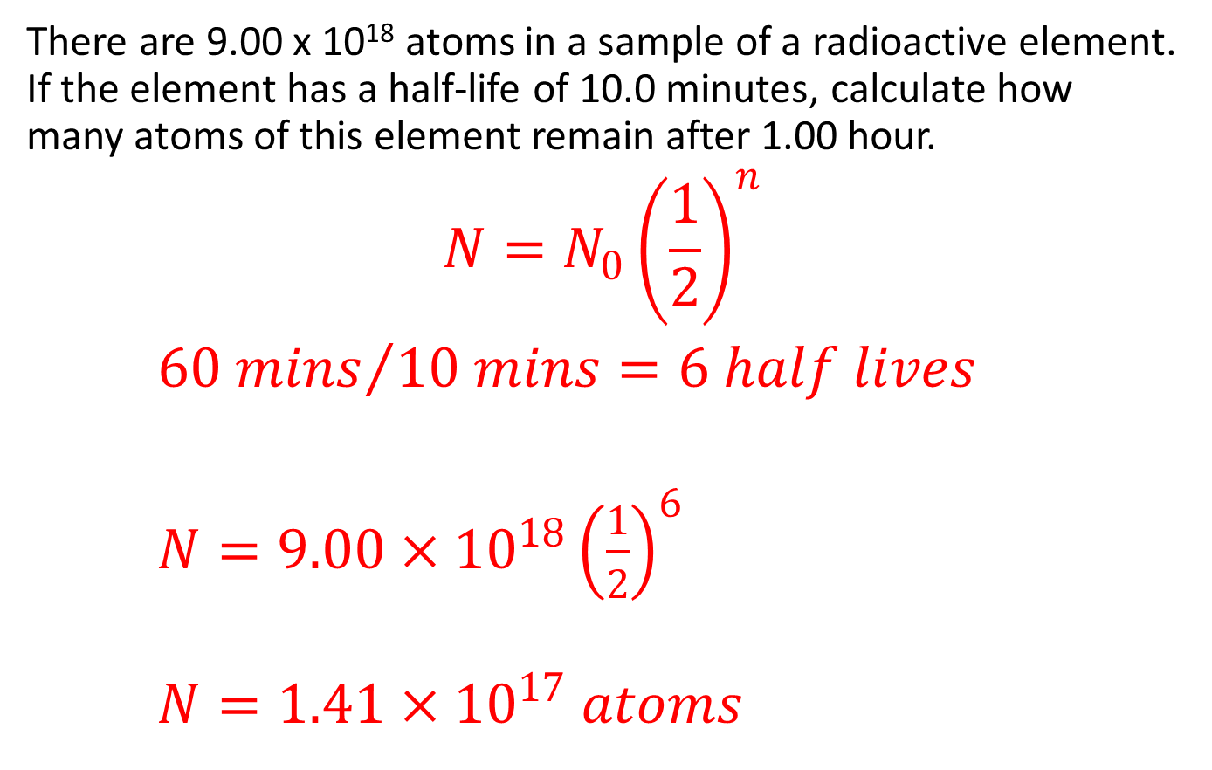
Solution
There are 9.00 x 10¹⁸ atoms in a sample of a radioactive element. If the element has a half-life of 10.0 minutes, calculate how many atoms of this element remain after 1.00 hour.
$$N=N_{0}{\left(\frac{1}{2}\right)}^{n}$$
${60 mins}/{10 mins}=6 half lives$
$N=9.00×{10}^{18}{\left(\frac{1}{2}\right)}^{6}$
$N=1.41×{10}^{17} atoms$

Slide 25

Question
A fossil was discovered to have only 12.5% of the total ${}_{6}^{12}C$ left. Based on this, how old was the fossil?

Slide 26
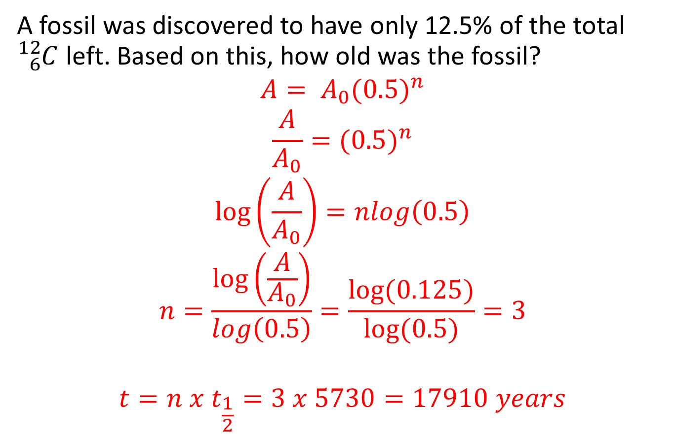
Solution
A fossil was discovered to have only 12.5% of the total ${}_{6}^{12}C$ left. Based on this, how old was the fossil?
$$A= A_{0}(0.5)^{n}$$
$$\frac{A}{A_{0}}=(0.5)^{n}$$
$$\log\left(\frac{A}{A_{0}}\right)=nlog\left(0.5\right)$$
$$n=\frac{\log\left(\frac{A}{A_{0}}\right)}{log\left(0.5\right)}=\frac{log⁡(0.125)}{log⁡(0.5)}=3$$
$$t=n x t_{\frac{1}{2}}=3 x 5730=17910 years$$

Slide 27

Half Life Example
The radioactive isotope gold-198 is a beta emitter. It is found that its activity drops to 1/8 of its original value in 8 days.
A) Write a decay equation for the isotope ${}_{79}^{198}{Au}$
B) Calculate its approximate half life
C) Estimate the fraction of gold-198 remaining after 2 weeks
Why is gold-198 chosen as a tracer to study the flow of sewage?

Slide 28
Example 2
A sample of Tc-99 has an activity of 8.0 x 10³ Bq. How many hours should it take for its activity to drop to 5.0 x 10² Bq? Tc-99 has a half-life of approximately 6 hours.

Slide 29

Question
Complete the following nuclear decay equations:
${}_{}^{240}{Pu}→ {}_{}^{240}{Pu}+$
${}_{11}^{24}{}→{}_{}^{24}{Mg}+$
${}_{89}^{221}{}→{}_{}^{217}{Fr}+$
${}_{84}^{210}{Po}→{}_{}^{4}{He}+$

Slide 30
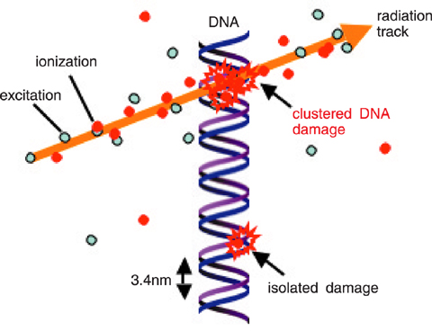
Radioactivity
Damage to biological tissue can lead to cell death

Slide 31
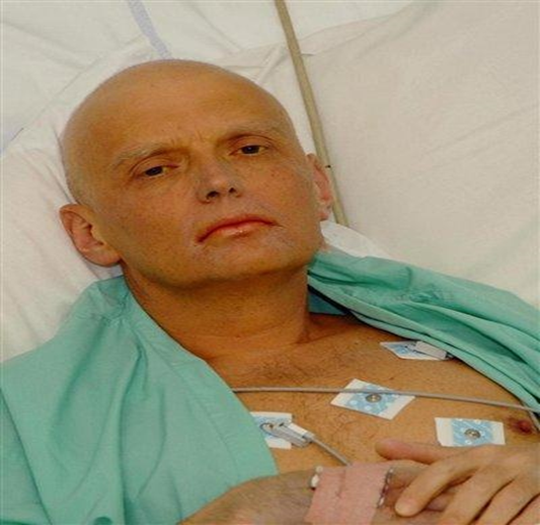
Radioactivity
Large doses of radiation can cause so many cell deaths that the body cannot make new copies quickly enough.
This leads to radiation sickness, characterised by fatigue, nausea and hair loss

Slide 32
Dosimetry
Large doses of radiation are also used to fight diseases such as cancer
Therefore defining the dose of radiation is important
The activity of the source of radiation is defined as the number of disintegrations per second. The unit is the becquerel (Bq)
1 Bq = 1 disintegration/s

Slide 33

Radiation Dose
The energy that our bodies receive from ionising radiation is referred to as the absorbed dose.
Specifically, the absorbed dose is the energy absorbed per kilogram of tissue.
The SI unit for absorbed dose is the gray (Gy). 1 Gy = 1 J kg⁻¹.

Slide 34
Quality Factor
The effects of different types of radiation on living cells varies.
Alpha particles, for example are far more ionising than gamma rays.
Hence equal doses of these two types of radiation can have quite different biological effects.
The quality factor for a particular radiation indicates the cell damage it causes in comparison to an equal dose of γ rays.
The dose equivalent (in Sieverts) is a measurement which incorporates the quality factor.
This means that 1 Sievert of any type of radiation will have the same biological effect.

Slide 35
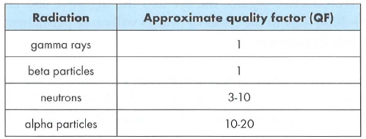
Quality Factor Table

Slide 36
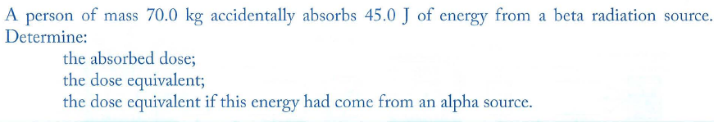
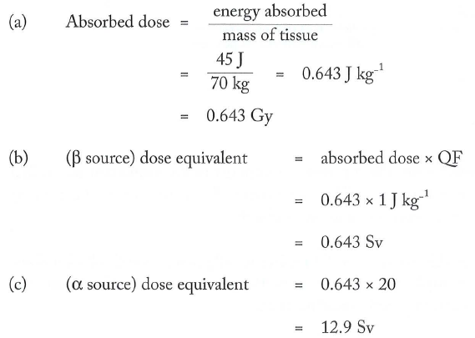
Example

Slide 37
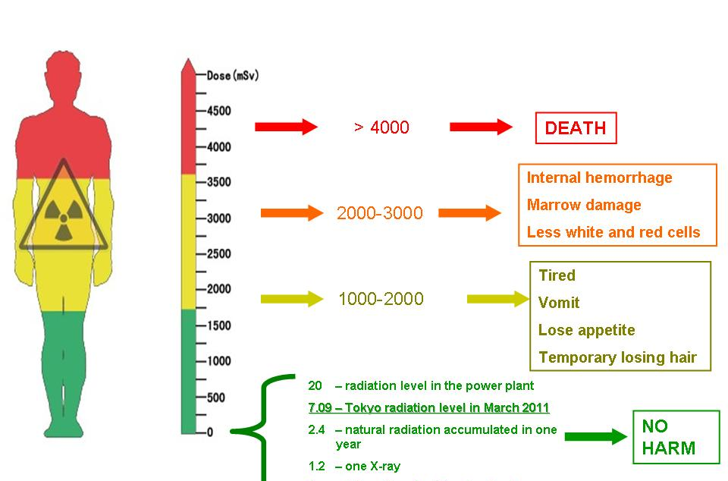
The Effective Dose Effects

Slide 38
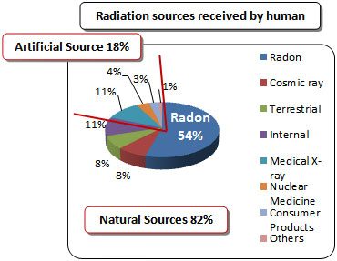
Annual Sources of Radiation

Slide 39
Effects of Ionising Radiation
Some parts of the body are more sensitive to ionising radiation than others.
The most sensitive are bone marrow, the reproductive organs, the eye and the digestive and circulatory systems.
For example, doses of 2000-3000 mSv to the testes or ovaries will cause permanent sterility while similar doses to the eye will result in cataracts.

Slide 40
Effects of Ionising Radiation
Lower doses of radiation may produce effects which only become apparent after several months or even years.
These include a reduced life expectancy, the development of leukaemia or tumours and cataracts on the eye lens.
Genetic damage, if it occurs, may not be apparent for several generations.

Slide 41
Example
A Geiger counter records 300 disintegrations in a 10 s period from a beta source. The beta rays have energy of 2 MeV. Find the activity, absorbed dose per second and effective dose for a 80 kg person per year.

Slide 42
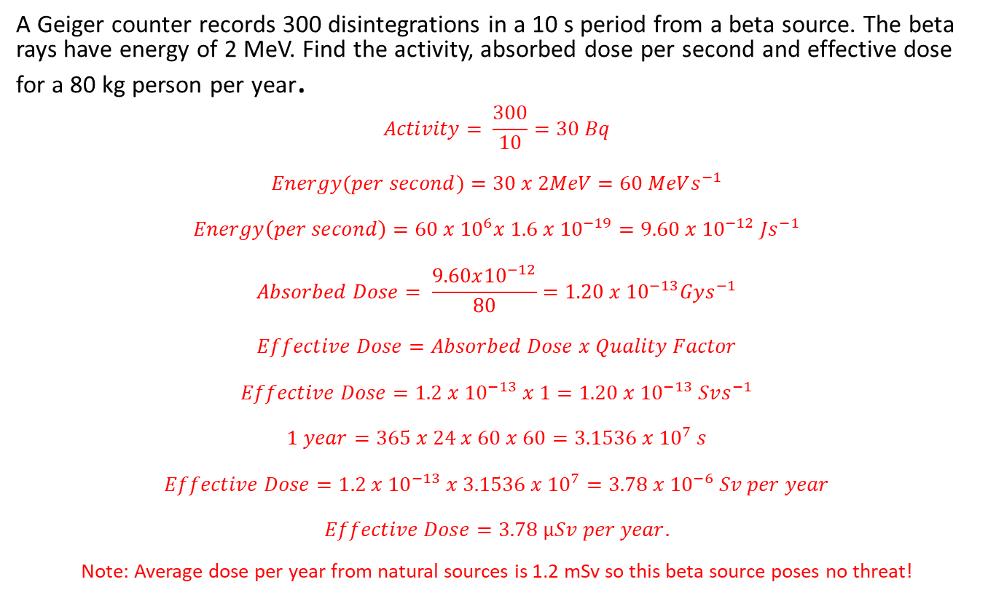
Solution
A Geiger counter records 300 disintegrations in a 10 s period from a beta source. The beta rays have energy of 2 MeV. Find the activity, absorbed dose per second and effective dose for a 80 kg person per year.
$$Activity= \frac{300}{10}=30 Bq$$
$$Energy(per second)=30 x 2MeV=60 MeVs^{−1}$$
$$Energy\left(per second\right)=60 x {10}^{6}x 1.6 x {10}^{−19}=9.60 x {10}^{−12} Js^{−1}$$
$$Absorbed Dose= \frac{9.60x{10}^{−12}}{80}=1.20 x {10}^{−13}Gys^{−1}$$
$$Effective Dose=Absorbed Dose x Quality Factor$$
$$Effective Dose=1.2 x{ 10}^{−13} x 1=1.20 x {10}^{−13} Svs^{−1}$$
$$1 year=365 x 24 x 60 x 60=3.1536 x {10}^{7} s$$
$$Effective Dose=1.2 x {10}^{−13} x 3.1536 x {10}^{7}=3.78 x {10}^{−6} Sv per year$$
$$Effective Dose=3.78 μSv per year.$$
Note: Average dose per year from natural sources is 1.2 mSv so this beta source poses no threat!

Slide 43
Your Turn
A doctor of mass 75.0 kg is taking images of a patient using a beta radiation source. If the radioisotope delivers 8.10 x 10⁻² J of energy, calculate the equivalent dose the doctor receives.

Slide 44


Student Feedback
What I learnt today…..
What I need to revise….
Images by clipart

